Slide 1
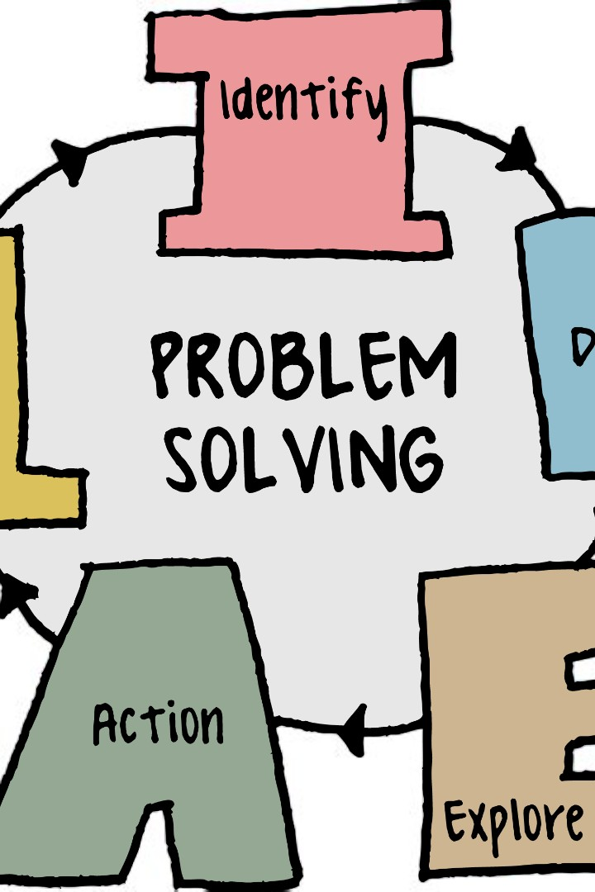
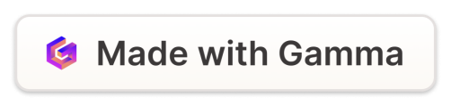
Problem Solving Presentation: Addressing a
Familiar/Local Issue
Spoken Production (MIDTERM) - 1+
Let's dive in!
by Jimena Rivadeneira, MA. TEFL.

Slide 2

Objective
Report straightforward information to indicate the nature of a problema as well as to present solutions.

Slide 3

OUTLINE of a PROBLEM-SOLVING PRESENTATION
Introduction
Problem explanation
Proposed solutions
Closing

Slide 4

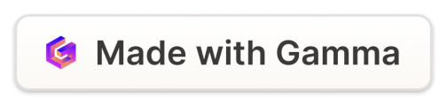
1. Introduction (30'')
1
Hook (catch the audience's attention - introduction of outline)
Start with an attention-grabber
2
Significance
Explain why this problem is important or relevant to your audience.
3
Purpose
State the purpose of the presentation.

Slide 5
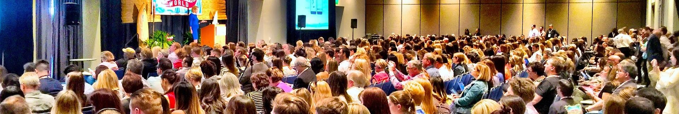
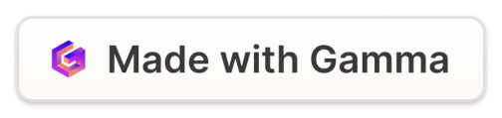
2. Problem explanation (1')
1
Identify the problem
Provide context and background information about the problem, including its history, causes, and impact.
2
Consequences
Discuss the consequences or negative effects of the problem on individuals, communities, or society. (2-max)

Slide 6

3. Proposed solutions (1')
Multiple Solutions
Describe potential solutions or strategies (2 -max).
1
Benefits
Highlight the advantages and benefits of each proposed solution.
2

Slide 7

4. Closing (30'')
Recap
Summarise the main points of your presentation, including the problem, its causes, and the proposed solutions.
1
Call to Action
Encourage and invite your audience to take action or support the implementation of the solution. (1 min)
Closing
Say thank you and bye.
2
3

Slide 8

Time Distribution
•
•
•
•
Introduction (30 seconds)
Problem explanation (1 minute)
Proposed solutions (1 minute)
Closing (30 seconds)

Slide 9

Assessment Criteria
1
PRONUNCIATION
How you say a word.
2
FLUENCY
How smoothly you speak
3
GRAMMAR AND VOCABULARY
Grammar refers to how well you use tenses, prepositions, verbs, etc.
Vocabulary refers to how
much vocabulary you know.
4
DELIVERY
Body language Attire
Visual aids Time limit
5
STRUCTURE
Introduction
Problem explanation
Proposed solutions
Closing
CONTENT
Content demonstrates that the student researched the topic for the presentation.
6

Slide 10


